Slide 1
Principles and Practices of Management
UNIT-III

Slide 2
STAFFING

Slide 3
STAFFING
After an organization's structural design is in place, it needs people with the right skills, knowledge, and abilities to fill in that structure.
According to Harold Koontz,
"Staffing means filling and keeping filled, positions in the organization structure.“
Management consists of getting work done through other people, hiring (acquiring) & retaining (keeping) the right people is one of the managers' most critical responsibilities.
Objective of staffing-
To hire right type of persons for right jobs.
To train and develop human resources
To develop personnel policies as regards transfer, promotion
Motivate them for higher performance

Slide 4
Nature of Staffing Function
Staffing is a pervasive activity- As staffing function is carried out by all mangers and in all types of concerns where business activities are carried out.
Staffing is a continuous activity- This is because staffing function continues throughout the life of an organization due to the transfers and promotions that take place.
The foundation of staffing function is efficient management of personnels- Human resources can be efficiently managed by a system or proper procedure, that is, recruitment, selection, placement, training and development, providing remuneration, etc.

Slide 5
Steps or elements or system approach for staffing
Manpower planning (number and type of staff required? shortage or surplus of manpower in various deptt, talents available in organization)
Requirement and selection
-Requirement (identification of the sources of manpower)
-Selection (choosing and appointing the right candidate for various jobs. it includes receiving, screening of applications, test, interview and medical examination of candidate).
3.Placement-when a new employee reports for duty, he is to be placed on the right job. if he can not work then use him on other job, if once again not then trained him.

Slide 6
Contd….
4.Induction or Orientation-detailed information about organization, working hours, tea or coffee breaks, lunch period, leaves, medical facility, transport facility etc.
5.Training and development- Enhance the knowledge and skills of the employee.
-Diff training program for diff manpower.
- on- the- job training is better for operative employees and off- the job for supervisors.
6.Compensation- Remuneration of workers involves fixation of their wages and salaries depending upon their level, nature of work, degree of risk etc.
7.Performance appraisal-rating or evaluation of the performance of the employees. transfer and promotion of the staff on the basis of performance.

Slide 7
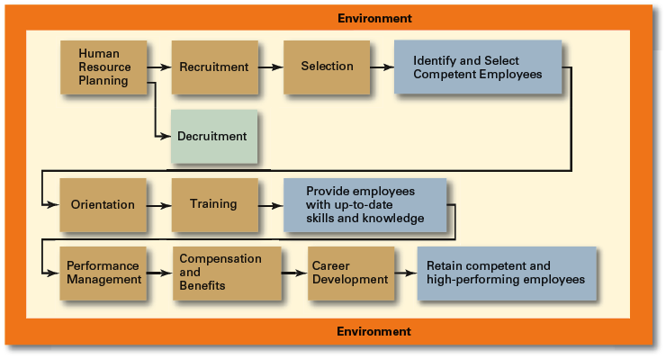
Human Resource Management Process
Systems approach

Slide 8
Need of Manpower Planning
Manpower Planning is advantageous to firm in following manner:
Shortages and surpluses can be identified so that quick action can be taken wherever required.
All the recruitment and selection programmes are based on manpower planning.
It also helps to reduce the labour cost as excess staff can be identified and so overstaffing can be avoided.
It also helps to identify the available talents in a concern and accordingly training programmes can be chalked out to develop those talents.

Slide 9
Steps to Successful Staffing
Recruit the right person:
Who is it you are looking for?
What skills, abilities and knowledge do you need?
What do they consider their strengths to be?
Have you a well-defined recruitment, screening and hiring policy?
Do you know the real reason why they left their previous employment position?
A List of Basic Personnel Policies
Hours of Work: Start time & Breaks & End Time. (Try Bonus for Attendance.)
Leave Vacation. Holidays. Sickness. Disability. Other Time Off.
Salary & Benefits: Rates. Allowances. Increase. Bonuses. Medical Benefits. Other Benefits:
Employee Development: Training. Self Study. Extra Courses.
Performance Review: Job Standards. Annual Review. Grievance Process

Slide 10
Steps to Successful Staffing
Conduct a regular Performance Appraisal:
Do they have an opportunity to give you feedback on the positions and how you are doing in supervising the employees?
How are you ready to serve your employees?
Do they consider you to be a fair employer?
Do they think you are treating everyone equally?
Byars & Rue – Recruitment Involves seeking & attracting a pool of people from which qualified candidates for job vacancies can be chosen
Decruitment
  The process of reducing a surplus of employees in the employees of an organization

Slide 11
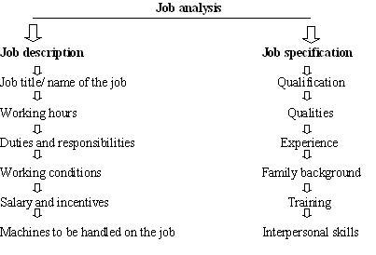
Job Analysis

Slide 12
Job design
“Job analysis” All information regarding the job.
“job description” and “job specification”
1.job Description-
-Statement of duties and responsibilities of a specific jobs.
-Describes the job itself, it usually includes:
job title or name, Job summary, Job location
Task and Duties to be performed
Working Environment
objective of each positions
Authorities and responsibilities
Relationship between this position and other positions (superiors , Subordinates and peers).

Slide 13
Job design
2.Job Specification
A written statement of the minimum qualifications that a person must possess to perform a given job successfully.
Job specification qualities required like educational qualification, experiences, health, appearance, mental ability etc.

Slide 14
Sources of Recruitment
Internal Recruitment
  Transfer (shifting from one job to another),
  Present , Permanent employees
  Promotion (advancement of an employee, greater skills, higher status, pay more money )
  Present Temporary employees
  Re-employment of ex-employees
  Dependents of diseased , disabled , retired and present employees
Advantage of Internal Recruitment Policy
Internal Candidate can handle new jobs easily.
Promotion will increase the confidence of the employee.
Better future opportunities for growth.
Cost of training will reduce.
The cost of internal recruitment is very low.

Slide 15
Contd….
Demerits of Internal Recruitment Policy
Better qualified outsiders may not be reached by the management.
Promotion policies may not be fair on the basis of seniority and ability.
Fresh talent into the organization will be restricted.

Slide 16
Contd….
External sources
If suitable candidates are not available in organization. More vacancies
To meet the demands of the company.
Direct recruitment (at factory gate for unskilled workers i.e. Budli workers ,no advertisement)
Casual callers(qualified persons called by phone whenever the need arises, cv already there.)
Advertising over diff parts of the country.
Employment exchange (Public employment exchanges) run by government
Placement agencies (Private employment agencies /consultants)
Campus recruitment (Educational & Training Institutes )

Slide 17
Contd….
7.Recommendations by the existing employees (Candidates introduced by friends & relatives of employees )
8.Telecasting (over Doordarshan and other channels)
9.Web publishing (internet,)
10.Data banks( naukri.com etc)
Merits
Large no of applicants
More deserving, talented candidate from outside.
Demerits
Dissatisfaction and frustration among internal employee bcoz wait for promotion.
More time taken and costly process

Slide 18
Selection
  An exercise in predicting which applicants, if hired, will be (or will not be) successful in performing well on the criteria the organization uses to evaluate performance.
Steps in the Selection procedure
Rejection of unsuitable candidate by following approach
Preliminary interview
Application forms and their screening
Employment tests
Final interview
Reference checking
Medical examination
Last step
Appointment letter

Slide 19
Recruitment and Selection
Basis | Recruitment | Selection
Meaning | It is an activity of establishing contact between employers and applicants. | It is a process of picking up more competent and suitable employees.
Objective | It encourages large number of Candidates for a job. | It attempts at rejecting unsuitable candidates.
Process | It is a simple process. | It is a complicated process.
Hurdles | The candidates have not to cross over many problems. | Many problems have to be crossed.
Approach | It is a positive approach. | It is a negative approach.
Sequence | First recruitment | It follows recruitment.
Economy | It is an economical method. | It is an expensive method.
Time Consuming | Less time is required. | More time is required.

Slide 20
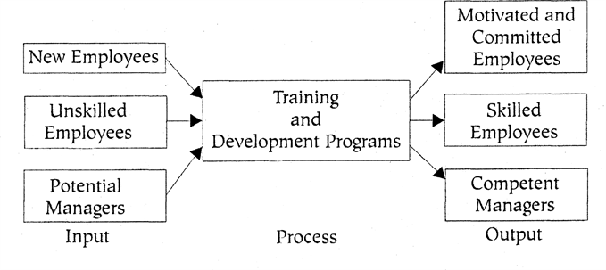
Training and Development

Slide 21
Training and Development
Training and Development
A framework for helping employees to develop their personal and organizational skills, knowledge, and abilities.
Edwin B.Flippo- “Training is concerned with increasing the knowledge and skills for doing specific jobs”.
Training is equally important for existing and as well as new employees.
Purpose of Training:
To improve Productivity: Training leads to increased operational productivity and increased company profit.
To improve Quality: Better trained workers are less likely to make operational mistakes.

Slide 22
Training and Development
To improve Organizational Climate: Training leads to improved production and product quality which enhances financial incentives. This in turn increases the overall morale of the organization.
To increase Health and Safety: Proper training prevents industrial accidents.
Personal Growth: Training gives employees a wider awareness, an enlarged skill base and that leads to enhanced personal growth.
Technology update-Increased capacity to adopt new technologies and methods.

Slide 23
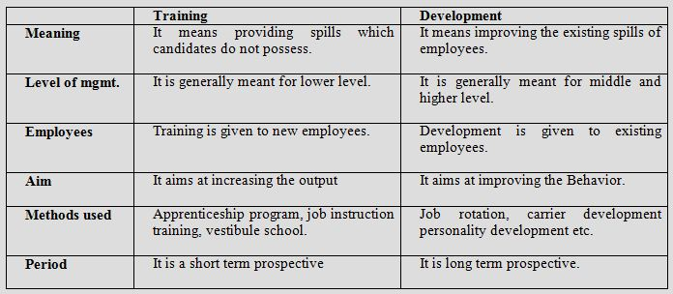
Training and Development

Slide 24
Training and Development
Training = Teaching New Skills
Development = Perfecting Existing Skills
Training:
It's a short term process.
Increasing skills and knowledge for doing a Specific job
Refers to instruction in technical and mechanical problems
Targeted in most cases for non-managerial personnel or operative workers
Development:
It is a long term educational process.
growth of employees in all aspects.
It shapes attitudes, technical, human, conceptual skills
Refers to philosophical and theoretical educational concepts
Managerial personnel
Depth knowledge oriented

Slide 25
Training Methods
On the job training (OJT)
-On-the-job training is the oldest form of training.
-On-the-job training takes place in a normal working situation, using the actual tools, equipment, documents or materials that trainees will use when fully trained.
-OJT can be delivered in classrooms as well. This type of training often takes place at the work place in informal manner by the immediate supervisor.
-On-the-job training, typically includes verbal and written instruction, demonstration and actual work environment.
--Training is not carefully planned or prepared.
-The trainers are selected on the basis of technical expertise or area knowledge
-

Slide 26
Training Methods
Cheaper and less time consuming
-Training is very relevant and practical dealing with day to day requirements of job
-Workers not taken away from jobs so can still be productive

Slide 27
Training Methods
Off-the-job training
-Takes place away from normal work situations
-The employee does not count as a directly productive worker while such training takes place.
-The workers are free of tension of work when they are learning.
-Learn from specialists in that area of work who can provide more in-depth study .
-Off-the-job training is the training done on behalf of employers, usually away from their premises.
-It can involve both theory (background knowledge) and practical training and may include assessment and examinations.
Examples--Distance learning / evening classes, Revision courses, Sponsored courses in higher education, Self-study, computer-based training

Slide 28
Training Types
Lectures and demonstrations; Attending external courses,
conference, seminar
Advantages of off-the-job training are:
(1)training can be more concentrated
(3) it is more suitable for theoretical instruction
(4) it can be less stressful.
Disadvantages of off-the-job training are:
(1) there may be no direct link between the training and the job
(2) it can be artificial
(3) trainers may not know the specific conditions of the employment
(4) it is usually more expensive Costs (transport, course fees, examination fees, materials, accommodation)

Slide 29
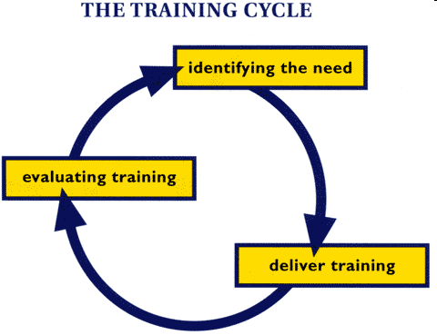
Training and Development

Slide 30
Training Methods
Traditional
Training Methods
  On-the-job
  Job rotation
  Mentoring and coaching
  Experiential exercises
  Workbooks/manuals
  Classroom lectures
Technology-Based Training Methods
  CD-ROM/DVD/videotapes/ audiotapes
  Videoconferencing/ teleconferencing/
  satellite TV
  E-learning

Slide 31
Selection Tools
Application Form – details of age, sex, Height and Weight, educational qualifications, experience etc
written examination – for screening purpose as a matter of elimination process – to know and measure the candidates’ position on knowledge , aptitude , reasoning and English language
Interviews
  Although used almost universally, managers need to approach interviews carefully.
Background Investigations
  Verification of application data
Physical Examinations
  Useful for physical requirements and for insurance purposes related to pre-existing conditions.

Slide 32
Interview
It is conducted with the most qualified applicants.
The purpose of interview is to obtain information, to give Information, and to determine if the applicant meets the requirements for the position.
The main aim of the interview is to learn about the potential of employee.
The interviewer judges-
The applicants soundness, reliability, capability, potential etc.
Willingness and ability to work with others,
Interest in the job,
The interviewer answer questions, explains policies and procedures, and help the applicant.

Slide 33
Orientation
Orientation
Is the process of informing new employees about the existing work environment & their place in it, so that they can relate quickly to their new surroundings.
overall purpose, function & structure of the organization as well as introduction to the rules Policies & procedures that apply to all employees (induction training).
The induction/introduction is the first 2-3 days of orientation, it can be done by personnel department employee for all new employees.

Slide 34
Orientation
Range of information that can be covered under orientation training-
Company’s vision and mission
Company’s history
Products of company
Location of departments
Employee’s activities
Rules and regulations
information about organisation
working hours
tea or coffee breaks, lunch period
Leaves, medical facility
Flow of authority and responsibility
transport facility, promotions, hiring and firing policies etc.

Slide 35

PERFORMANCE APPRAISAL

Slide 36
Performance Appraisal / Assessment
Objective
To provide a record of each employee’s performance for the purpose of determining wages and incentives.
To identify the employees who have been placed on the wrong job to transfer them to the jobs for which they are better suited.
Identify the quality ,strength and weakness of each employee.
To design training programme for the improvement of the quality of employees.
It is a periodic formal evaluation of how well personnel have performed their duties during a specific period.

Slide 37
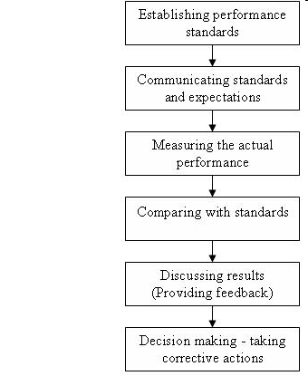
Performance Appraisal

Slide 38
Performance Appraisal
Method of Performance appraisal-
I.Ranking on the basis of job performance (Ist and last rank)
-in this way every employee is compared with every other employee in the same job family.
The ranking process must be done in a specified manner (for example, by first selecting the best employee in a group, then the worst, then the second-best, then the second-worst, etc.).
II.Checklist appraisal-
-Various statements are prepared in such a manner that they describe various types of behavior of an individual on a particular job.
-Each statement is attached a scale value.

Slide 39
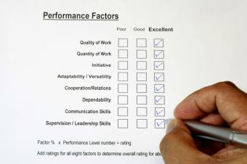

Slide 40
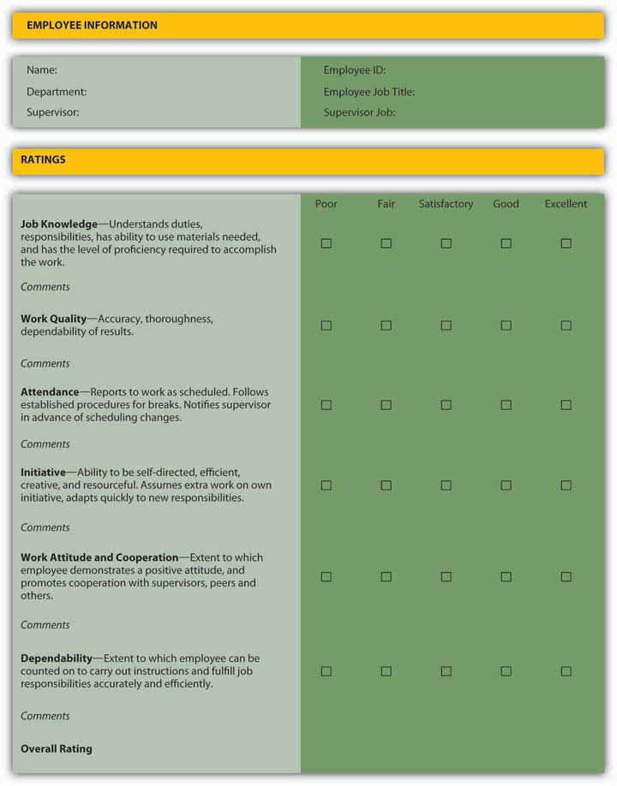

Slide 41
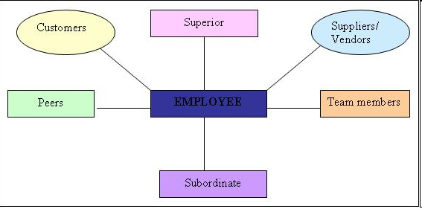
Performance Appraisal
III- 360 Degree appraisal and feedback

Slide 42


Slide 43
Performance Appraisal
4-Forced Distribution (outstanding, above average, average, below average and poor like 10% are above average and so on.
10 percent low; 20 percent below average; 40 percent average; 20 percent above average; and 10 percent high.
In a group of 20 employees, two would have to be placed in the low category, four in the below-average category, eight in the average, four above average, and two would be placed in the highest category.

Slide 44

Directing
Directing means giving instructions, guiding, counseling, motivating and leading the staff in an organization in doing work to achieve Organizational goals.
Directing is a key managerial function to be performed by the manager along with planning, organizing, staffing and controlling.
Directing is a continuous process initiated at top level and flows to the bottom through organizational hierarchy.

Slide 45
Directing / Leading
The direction function involves the following four elements:
Leadership: Guiding & influencing the work of others in choosing and attaining specified goals.
Communication: Telling the workers exactly what they are required to do, how to do and when to do it. Creates clear understanding in the minds of others.
Motivation: To motivate the people to work harmoniously for the attainment of desired objectives.
Supervision: A process to check agreement between planned and actual result is maintained to ensure great quality of output.

Slide 46
Importance of directing function
1. Direction initiates actions. Organisation is the sum-total of human and non-human resources.
These resources should be handled in a certain way to get the desired results.
Through direction, management conveys and motivates individuals in the organisation to function in the desired way to get organisational objectives.
Without direction, other managerial activities like planning, organising and staffing become ineffective.
2. Direction attempts to get maximum out of individuals. Every individual in the organisation has some potentiality and capability which, in the absence of proper motivation, leadership, communication-all element of direction-may not be utilised fully.

Slide 47
Direction provides the way to utilize these capabilities and also it helps in increasing these capabilities.
3. Direction provides stability and balance in the organization. Effective leadership, communication and motivation, provide stability in the organisation and maintain balances in the different part of the organisation.

Slide 48
MOTIVATION

Slide 49
MOTIVATION
Motivation is the core of management. Technically, the term motivation can be traced to the Latin word movers, which means 'to move'.
Motivating is a term which implies that one person encourages another, to engage in action
Term motive-anything that initiates or sustains activity. positive behaviour towards goal.
Robert Dubin “ motivation is the complex of forces starting and keeping a persons at work in an organization. motivation is something that moves the person to action in positive direction.

Slide 50
MOTIVATION
Need and Significance of motivation
Maximum output, productivity, goal fulfillment.
The no. of complaints and accidents rate will be low.
Quality and quantity of products will increase.
Worker’s satisfaction, Promotes better quality of work with less wastage
Creates ‘will to work’ to achieve the goal.
Motivation is an effective instrument in the hands of manager for inspiring the employees and creating a confidence in it.
Early Theories of Motivation
Maslow’s Hierarchy of Needs
MacGregor’s Theories X and Y
Herzberg’s Two-Factor Theory

Slide 51
Early Theories of Motivation
Maslow’s Hierarchy of Needs Theory
A.H. Maslow developed a conceptual framework for understanding human motivation
  Needs were categorized as five levels of lower- to higher-order needs.
    Individuals must satisfy lower-order needs before they can satisfy higher order needs.
    Motivating a person depends on knowing at what level that person is on the hierarchy.
  Hierarchy of needs
    Lower-order (external): physiological, safety
    Higher-order (internal): social, esteem, self-actualization

Slide 52
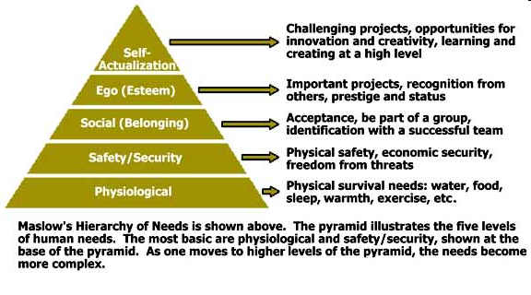
Maslow’s Hierarchy of Needs

Slide 53
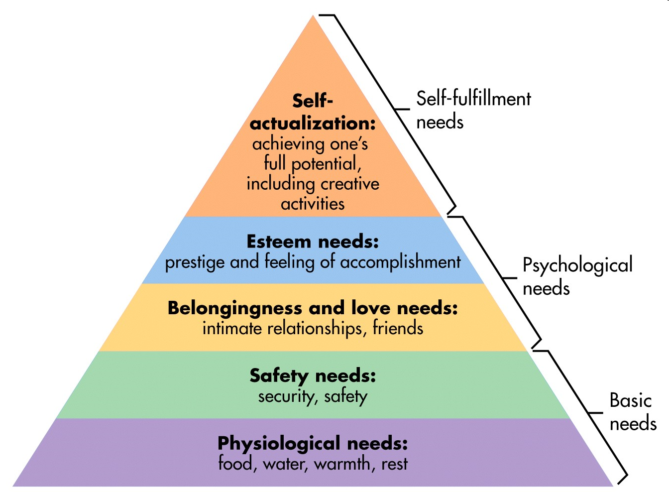
Maslow’s Hierarchy of Needs

Slide 54
Maslow’s Hierarchy of Needs
1.Physiological Needs
Physiological needs are those required to sustain life, such as:
air ,water ,food, sleep
Also, there’s the needs to be active, to rest, to sleep
These include the needs we have for oxygen, water, protein, salt, sugar, calcium, and other minerals and vitamins.
They also include the need to maintain a pH balance (getting too acidic or base will kill you) and temperature (98.6 or near to it).
According to Maslow's theory, if such needs are not satisfied then one's motivation will arise from the mission to satisfy them.
Higher needs such as social needs and esteem are not felt until one has met the needs basic to one's physical functioning.

Slide 55
Maslow’s Hierarchy of Needs
2.Safety
Once physiological needs are met, one's attention turns to safety and security in order to be free from the threat of physical and emotional harm. Such needs might be fulfilled by:
Living in a safe area
Medical insurance
Job security
Financial reserves
According to Maslow's hierarchy, if a person feels that he or she is in harm's way, higher needs will not receive much attention.

Slide 56
Maslow’s Hierarchy of Needs
3.Social Needs
Once a person has met the lower level physiological and safety needs, higher level needs become important, the first of which are social needs. Social needs are those related to interaction with other people and may include:
Need for friends
Need for belonging
Need to give and receive love
When physiological needs and safety needs are, by and large, taken care of, a third layer starts to show up.
You begin to feel the need for friends, a sweetheart, children, friendly relationships in general, even a sense of community.

Slide 57
Maslow’s Hierarchy of Needs
We show these needs in our desires to marry, have a family, be a part of a community, a member of a church, a brother in the society, a part of a gang or a club.
4.Esteem
Once a person feels a sense of "belonging", the need to feel important arises.
Esteem needs may be classified as internal or external.
Internal esteem needs are those related to self-esteem such as self respect and achievement.
External esteem needs are those such as social status and recognition. Some esteem needs are:
Self-respect ,Achievement, Attention, Recognition, Reputation , status, fame, glory, appreciation, dignity, even dominance, Power, authority, control.

Slide 58
Maslow’s Hierarchy of Needs
The higher form involves the need for self-respect, including such feelings as confidence, competence, achievement, independence, and freedom.
The negative version of these needs is low self-esteem and inferiority complexes.
People from different cultures have different values and norms, and therefore have different criteria or have criteria which are perceived as more important e.g. Greek and Japanese employees stated that safety and physiological needs are more important to them, where as employees from Norway and Sweden saw belongingness needs as being more important.

Slide 59
Maslow’s Hierarchy of Needs
5.Self actualization
Dr. Abraham Maslow first coined the term "self actualization. Here is what he has to say on the subject:
"What a man can be, he must be. This need we may call self-actualization…
"A musician must make music, an artist must paint, a poet must write, if he is to be at peace with himself. What a man can be, he must be.
This is the need we may call self-actualization ... It refers to man's desire for fulfillment, namely to the tendency for him to become actually in what he is potentially:
to become everything that one is capable of becoming
“ Be what u want to be..."

Slide 60
Self-Actualization
It is the mission of reaching one's full potential as a person. Unlike lower level needs, this need is never fully satisfied
as one grows psychologically, there are always new opportunities to continue to grow.
Self-actualized people tend to have needs such as:
Truth , Justice, Wisdom, Meaning
Self-actualized persons have frequent occurrences of peak experiences, which are energized moments of profound happiness and harmony.
According to Maslow, only a small percentage of the population reaches the level of self-actualization.

Slide 61
Early Theories of Motivation (cont’d)
Herzberg’s Motivation-Hygiene Theory
American psychologist
Herzberg’s Motivation-Hygiene Theory, also known as Two Factor Theory, was developed by Frederick Herzberg, a psychologist who found that job satisfaction and job dissatisfaction acted independently of each other.
He felt that there were two types of factors affecting motivation and job satisfaction, namely
Hygiene and maintenance factors ("dissatisfiers"),
Motivators or growth factors ("satisfiers").

Slide 62
Herzberg’s Motivation-Hygiene Theory
Motivators (e.g. challenging work, achievement, recognition, responsibility, nature of the work, personal growth and advancement) which give positive satisfaction,
Hygiene factors (e.g. status, salary, job security, working conditions, level and quality of supervision, company policy and administration and interpersonal relations, ) which do not give positive satisfaction, although dissatisfaction results from their absence.
hygiene factors are needed to ensure an employee is not dissatisfied.
Motivation factors are needed in order to motivate an employee to higher performance.

Slide 63
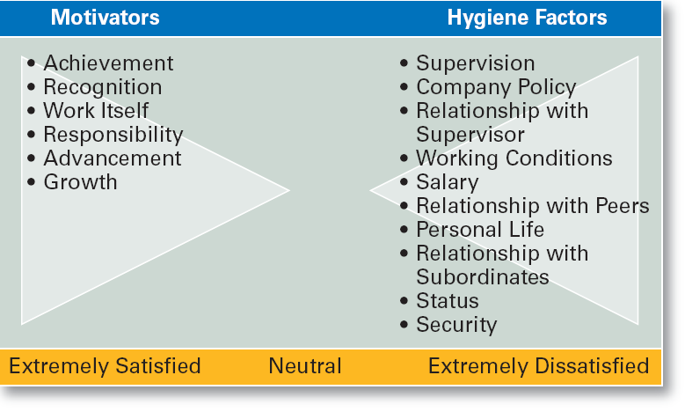
Herzberg’s Motivation-Hygiene Theory

Slide 64
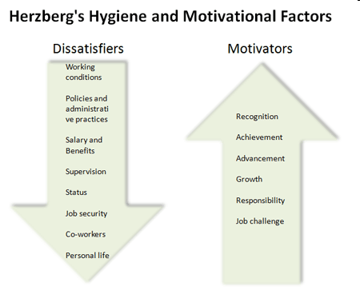
Herzberg’s Motivation-Hygiene Theory

Slide 65
Herzberg’s Motivation-Hygiene Theory
Anything wrong with the hygiene factors is a source of dissatisfaction for the individual and cannot be motivators.
People are made dissatisfied by a bad environment, but they are rarely made satisfied by a good environment.
Hygiene factors operate independently of motivation factors. An individual can be highly motivated in his work and be dissatisfied with his work environment.

Slide 66
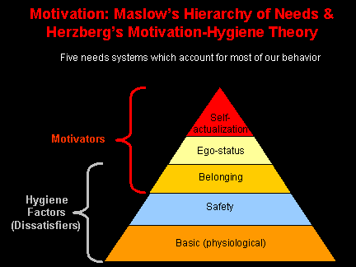
Maslow vs. Herzberg’s Motivation

Slide 67
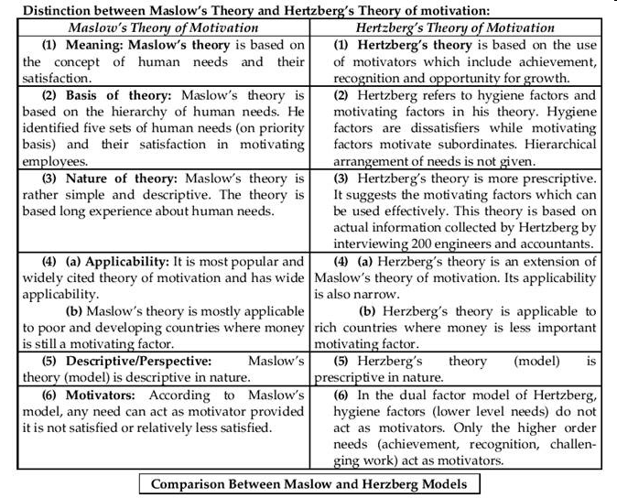

Slide 68
Maslow vs. Herzberg’s Motivation
Similarities:
Both use a hierarchical scale..where one stage must first be fully or largely completed before advancing to the next stage.
Both are based on the argument that "we behave as we do because we are attempting to fulfill internal needs.”
They both specify the criteria as to what motivates people.
However, this is controversial because entrepreneurs and people from different cultures have different values and norms, and therefore have different criteria or have criteria which are perceived as more important e.g. Greek and Japanese employees stated that safety and physiological needs are more important to them, where as employees from Norway and Sweden saw belongingness needs as being more important.

Slide 69
Maslow vs. Herzberg’s Motivation
Herzberg's hygiene idea corresponds with Manslow's Physiological, Safety and Belongingness needs i.e. they both have the same critieria (basic pay, work conditions etc...)
Also, Herzberg's motivators idea corresponds with Manslow's Esteem and Self-Actualisation needs i.e. they both have the same criteria (recognition, growth, achievement etc...).
Both theories are influenced by environmental conditions, employee attitudes and as a result, their motivation. These influence an employees performance.

Slide 70
Maslow vs. Herzberg’s Motivation
Differences:
Maslow says that each stage of the 5 must be fully or largely completed before advancing to the next stage..however, Herzberg suggested that there were only 2 stages (hygiene and motivators) instead of 5.
Maslow said that fulfilling each stage is a motivator, however Herzberg said that fulfilling the hygiene stage only results in an employee being in neutral state and that satisfaction and motivation only comes from the 2nd stage (motivator).
Basis of Theory ↓
Maslow's theory is based on the hierarchy of human needs. He identified five sets of human needs (on priority basis) and their satisfaction in motivating employees.

Slide 71
Maslow vs. Herzberg’s Motivation
Hertzberg refers to hygiene factors and motivating factors in his theory. Hygiene factors are dissatisfiers while motivating factors motivate subordinates. Hierarchical arrangement of needs is not given.
Maslow's theory is rather simple and descriptive. The theory is based long experience about human needs.
Hertzberg's theory is more prescriptive. It suggests the motivating factors which can be used effectively. This theory is based on actual information collected by Hertzberg by interviewing 200 engineers and accountants.

Slide 72
Maslow vs. Herzberg’s Motivation
Applicability of Theory ↓
Maslow's theory is most popular and widely cited theory of motivation and has wide applicability. It is mostly applicable to poor and developing countries where money is still a big motivating factor.
Herzberg's theory is an extension of Maslow's theory of motivation. Its applicability is narrow. It is applicable to rich and developed countries where money is less important motivating factor.

Slide 73
Contd….
Theory X and Theory Y are theories of human motivation created and developed by Douglas McGregor
Theory X assumes that the average person:
Dislikes work and attempts to avoid it.
Has no ambition, wants no responsibility, and would rather follow than lead.
Is self-centered and therefore does not care about organizational goals.
Resists change.
Is innocent and not particularly intelligent.
Essentially, Theory X assumes that people work only for money and security.

Slide 74
Contd….
Theory Y makes the following general assumptions:
Work can be as natural as play and rest.
People will be self-directed to meet their work objectives if they are committed to them.
People will be committed to their objectives if rewards are in place that address higher needs such as self-fulfillment.
Under these conditions, people will seek responsibility.

Slide 75
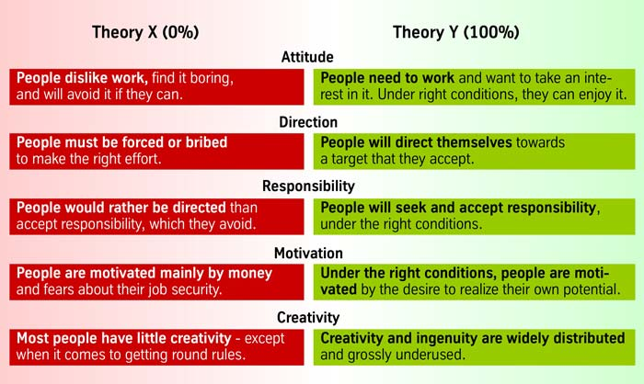
Contd….

Slide 76
Three-Needs Theory (McClelland)
Three-Needs Theory (McClelland)
David McClelland's theory sometimes is referred to as the three need theory
A person's motivation and effectiveness in certain job functions are influenced by these three needs.
  There are three major acquired needs that are major motives in work.
  Need for achievement (nAch)
      -The drive to excel and succeed
    Need for power (nPow)
      The need to influence the behavior of others
    Need of affiliation (nAff)
      The desire for interpersonal relationships

Slide 77
Three-Needs Theory (McClelland)
The need for power (N-Pow)
“power over others”. This is the need to lead others and make an impact.
A person's need for power (nPow) can be one of two types - personal and institutional.
Those who need personal power want to direct others, and this need often is perceived as undesirable.
Persons who need institutional power (also known as social power) want to organize the efforts of others to further the goals of the organization.
Managers with a high need for institutional power tend to be more effective than those with a high need for personal power.

Slide 78
Three-Needs Theory (McClelland)
The need for achievement (N-Ach);
This is the need to achieve, excel and succeed.
A person with this type of need, will set goals that are challenging but realistic.
The goals have to be challenging so that the person can feel a sense of achievement. However the goals also have to be realistic as the person believes that when a goal is unrealistic, its achievement is dependant on chance rather than personal skill or contribution.

Slide 79
Three-Needs Theory (McClelland)
The need for affiliation (N-Affil);
This is the need for friendly relationships and human interaction.
Those with a high need for affiliation (nAff) need harmonious relationships with other people and need to feel accepted by other people.
There is a need “to feel liked” and “accepted” by others. A person with a high need for affiliation is likely to be a team player and thrive in a customer services environment. They will perform best in a co-operative environment.
McClelland said that a strong need for affiliation will interfere with a manager’s objectivity. The “need to be liked” will affect a manager’s decisions, prompting them to make decisions to increase their popularity rather than furthering the interests of the organisation.
Note that McClelland's theory allows for the shaping of a person's needs; training programs can be used to modify one's need profile.

Slide 80
Approaches for Improving Motivation
Managerial Approaches for Improving Motivation:
A number of approaches can help managers motivate workers, to perform more effectively. The following steps promote basic motivation:
Workers Participation in Management (WPM)
Management by Objectives (MBO)
Organization Behavior Modification
Job-Redesign
Alternative Work Schedules.

Slide 81
Approaches for Improving Motivation
Pay and Job Performance:
Pay often can be used to motivate employee performance. But a pay plan also must be able to do the following tasks:
Create the belief that good performance leads to high levels of pay;
The reality is that sometimes incentive plans for job performance are needed to get peak productivity out of your staff.
A company can offer performance incentives to help motivate employees to give a maximum effort at all times. Pay Bonuses
incentive

Slide 82
Approaches for Improving Motivation
An extra week of paid vacation can be a strong financial incentive for employees to perform at a high level to remain with the company.
Getting a portion of a college education paid for by the company helps to develop the employee's career and increases the skill set available to the company.

Slide 83
Approaches for Improving Motivation
Quality of Work Life Programs:
Quality of Work Life (QWL) is defined as an attempt through a formal program to integrate employee needs and well being with the intention of improved productivity, greater worker involvement and higher levels of job satisfaction.
job satisfaction, life satisfaction, happiness, and safe work environment,
equitable wages,
equal employment opportunities and opportunities for advancement.

Slide 84
Approaches for Improving Motivation
The components of Quality of Work Life may vary from organization to organization, individual to individual but some of the basic components are –
Free communications –
Reward system – reward is related to monetary or non monetary rewards eg- incentives, movie tickets, family health insurance, sponsoring the education of children etc. any kind of reward given to the employee promotes good quality of work life.
Employee job security - job security is the one vital element to get maximum productivity from the employee, the employee should feel secured regarding the job.

Slide 85
Quality of Work Life Programs
Career growth – the organization should provide career growth to the employee i.e promotion, authority with responsibility ,hike in the salary to retain the talented employee.
Workers participation in decision making of the organization – employees should be encouraged to take participate actively in the decision making body of the organization so that should feel that we are also of some value to the employers.
They will be more loyal, committed towards the organization.
Stress level – stress level should not be in proportion to the work life.
Higher the stress level poor is the quality of work life, lower is the stress level higher is the quality of work life

Slide 86
Motivation and Goals
Goal-Setting Theory
  Proposes that setting goals that are accepted, specific, and challenging yet achievable will result in higher performance than having no or easy goals.
  Is culture bound to the U.S. and Canada.
Benefits of Participation in Goal-Setting
  Increases the acceptance of goals.
  Fosters commitment to difficult, public goals.
  Provides for self-feedback (internal locus of control) that guides behavior and motivates performance (self-efficacy).

Slide 87
Current Issues in Motivation
Cross-Cultural Challenges
  Motivational programs are most applicable in cultures where individualism and quality of life are cultural characteristics
    Uncertainty avoidance of some cultures inverts Maslow’s needs hierarchy.
    The need for achievement (nAch) is lacking in other cultures.
    Collectivist cultures view rewards as “entitlements” to be distributed based on individual needs, not individual performance.
  Cross-Cultural Consistencies
    Interesting work is widely desired, as is growth, achievement, and responsibility.

Slide 88
Current Issues in Motivation (cont’d)
Motivating Unique Groups of Workers
  Motivating a diverse workforce through flexibility:
    Men desire more autonomy than do women.
    Women desire learning opportunities, flexible work schedules, and good interpersonal relations.

Slide 89
Current Issues in Motivation (cont’d)
Flexible Work/Job schedules
  Compressed work week
    Longer daily hours, but fewer days
  Flexible work hours (flextime)
    Specific weekly hours with varying arrival, departure, lunch and break times around certain core hours during which all employees must be present.
  Job Sharing
    Two or more people split a full-time job.
  Telecommuting
    Employees work from home using computer links.

Slide 90
Current Issues in Motivation (cont’d)
Motivating Professionals
  Characteristics of professionals
    Strong and long-term commitment to their field of expertise.
    Loyalty is to their profession, not to the employer.
    Have the need to regularly update their knowledge.
    Don’t define their workweek as 8:00 am to 5:00 pm.
  Motivators for professionals
    Job challenge
    Organizational support of their work

Slide 91
Current Issues in Motivation (cont’d)
Motivating Contingent Workers
  Opportunity to become a permanent employee
  Opportunity for training
  Equity in compensation and benefits
Motivating Low-Skilled, Minimum-Wage Employees
  Employee recognition programs
  Provision of sincere praise

Slide 92
Long\Short Questions
What is meant by staffing? Who is responsible for staffing.
2. Discuss the need and significance of staffing and personnel management in modern organisation.
3. What is manpower planning? What are its benefits to an industrial enterprise?
4. Explain the steps in the process of job analysis.
5. What is meant by recruitment? Distinguish between recruitment and selection of employees.
6. Discuss the different sources of recruitment of employees for a big organisation.

Slide 93
Long\Short Questions
7. Define recruitment. What are the merits and demerits of external sources of recruitment?
8. As personnel manager of a large company, what sources of recruitment would you prefer in filling up clerical vacancies?
9.Define promotion.compare the merits and demerits or recruitment through promotion and recruitment from outside.
10. Explain in brief the selection procedure fillowed by an industrial organisation with which you are familiar.
11. Define training.explain the importance of training to an industrial concern.
12. What is meant by training ? What are its objectives? How is it different from development?

Slide 94
Long\Short Questions
13.Explain briefly any three methods of training to employees.
14. What is meant by on-the-job training? Discuss any two such methods.
15. Explain the concept of performance appraisal and indicate its principle benefits.
16. What are the different methods of performance appraisal?
17. Discuss the MBO approach to performance apprasial. What are its limitations?
18. What is potential appraisal? Briefly discuss the mechanisms of potential appraisal.
19. “direction is the essence of management process”. Explain.

Slide 95
Long\Short Questions
20.Discuss the nature and importance of direction in managing. What are the elements of direction?
21.Discuss the importance of effective supervison in modern organisation.
22.Distinguish between supervision and direction.state the functions of a supervisor.
23.Explain the concept,nature and significance of motivation.
24. What is motivation? What does maslow’s hierarchy of needs tell us about people’s need?
25. Explain Herzberg’s two-factor theory and differentiate it from maslow’s theory of need hierarchy.

Slide 96
Long\Short Questions
26. Distinguish between hygiene factors and motivation factors. To what extent is Herzberg’s theory of motivation useful in practical management?
27.How do McGregor’s theory X and theory y of human behaviour help motivation of employees?which one is applicable in india?
28. Explain theory Z of motivation. Do you think this theory is the answer to the problem of low level of motivation in indian industry.
29. “Ouchi’s theory Z is the last word on motivation.”comment.what are the basic features of this theory?

Slide 97
Long\Short Questions
30. “ money holds the key to work motivation in modern business organisation.”discuss and explain the role of non-financial incentives in motivation.
31.Discuss the conditions for success of quality of working life in an organisation.
32.What is meant by job enlargement?how is it different from job enrichment?
33.Discuss the nature and significance of morale. Describe the relationship between morale and productivity.

Slide 98
Thanks…
REFERNCES:-
Koontz,”Principles of management”,TMH,2008
Robbins and Coulter,”Management”,PHI
L.M.Prasad,”Principles and Practices of management”
T.Ramasamy “Principles of Management.”
T.N.Chhabra “Essentials of Management”
Google.co.in etc.

